Slide 1

Community Efforts to Reduce the Impacts of Climate Change on Livelihoods and Food Security
Charles O Nyandiga (PhD)
UNDP GEF SGP, CBA Focal Point, NY USA

Slide 2
CLIMATE CHANGE
Theory:
Increased Human Population lead to increase fossil fuel use.
Fossil Fuel use releases pollutants.
  But, does this increase in Greenhouse gases initiate climate change?
Some of these pollutants are Greenhouse Gases.
  These gases “trap” long wave radiation in the Earth’s Atmosphere.
Trapping long wave radiation (heat), results in the overall warming of the Earth’s Atmosphere
But, does this increase in Greenhouse gases initiate climate change?

Slide 3
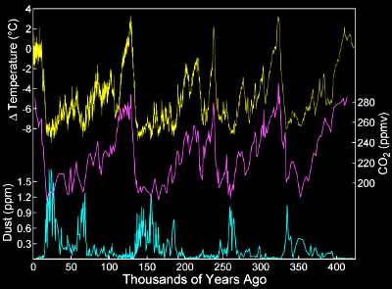
What causes climate change?
Solar Forcing (subtle changes)
Volcanic Forcing (dust and global cooling)
Anthropogenic Forcing
http://www.sciencebits.com/CO2orSolar

Slide 4
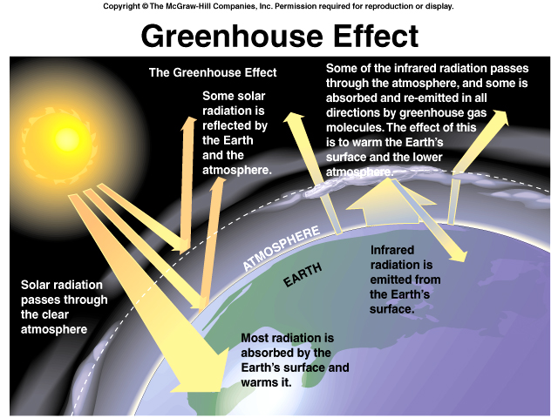

Slide 5
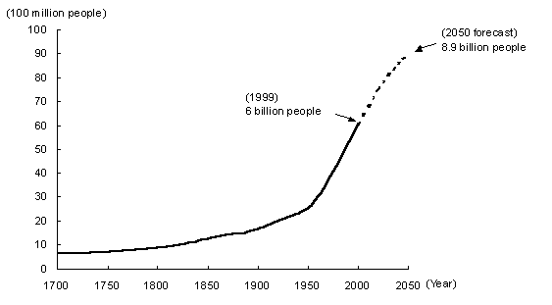
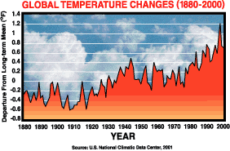
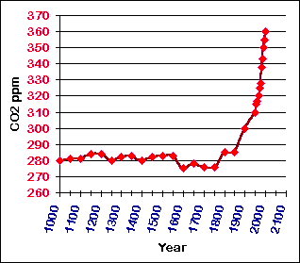
Global Climate Change
Analysis of last 1000 years of climate show changes that cannot be explained by solar forcing or volcanic forcing.
The changes point to anthropogenic effects, and especially when looked at alongside known historical events

Slide 6
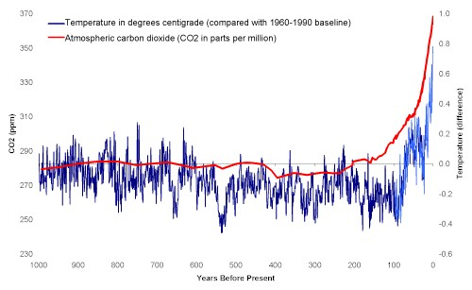
CO₂ and Temperature change over past 1000 years
NOAA, 2003

Slide 7
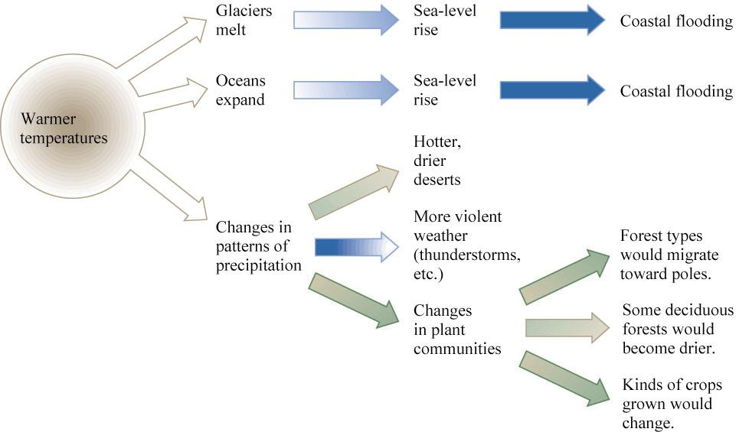
Effects of Global Warming
Not uniform; regional differences
  some areas hotter, some colder, some wetter, some dryer!!!
These local, regional changes are difficult to predict

Slide 8
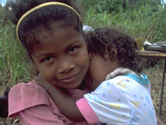

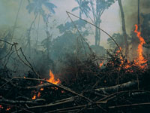
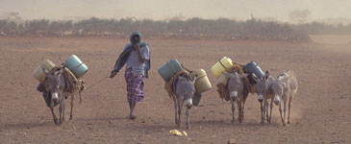
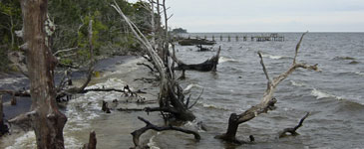
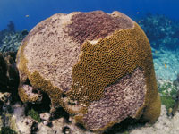
Climate Change Impacts: What Needs to be Managed
Variability in water supply, quality and distribution. More competition and cross-border conflicts over water resources
Erosion, inundation, salinisation, stress on mangroves, marshes, wetlands
Changes in forest composition,
extent, health & productivity
PUBLIC
HEALTH
WATER
RESOURCES
COASTAL
SYSTEMS
ECOSYSTEM
SERVICES
AGRICULTURE
FORESTRY
Less predictability in crop yield, changing irrigation demand, growing risk of pest infestations
Increasing incidents of infectious, water-borne and vector-borne diseases, heat stress & mortality, additional public health costs
Loss of habitat, species and protective ecosystems, migratory shifts

Slide 9
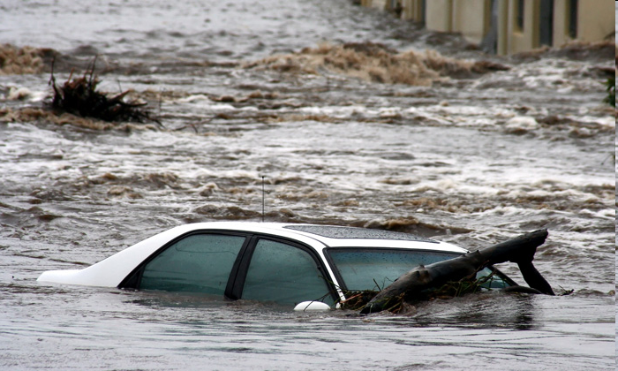
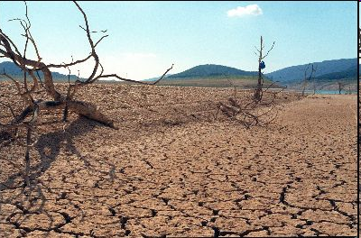
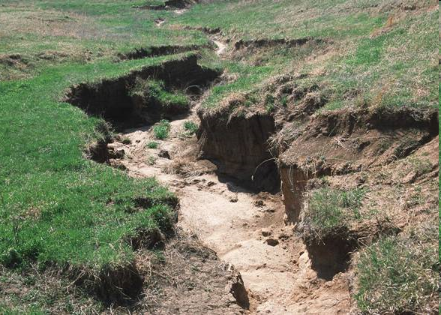
Effects on Community, farmers
Some years, too little In some, too much
rain

Slide 10
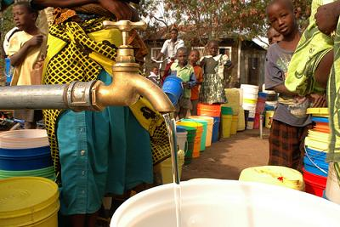
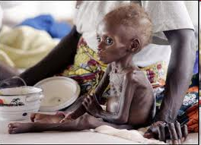
Effects continue….
Water shortage
Diseases - vulnerable groups more at risk, food shortage
Unproductive land/livestock
Food insecurity
Conflicts over resources
Poverty increases

Slide 11
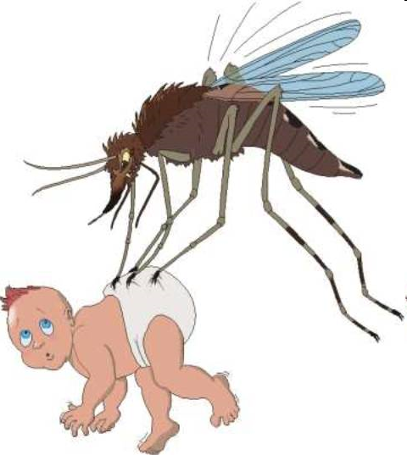
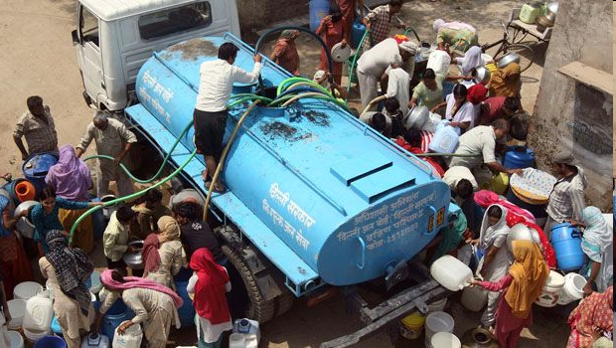
Implications….
More incidences of diseases e.g. malaria
More and longer drought/wet periods
More soil erosion and degraded land
Plant genetic and agro-ecological changes
Unsustainable water sources
Humanity future in Jeopardy
ETC.

Slide 12
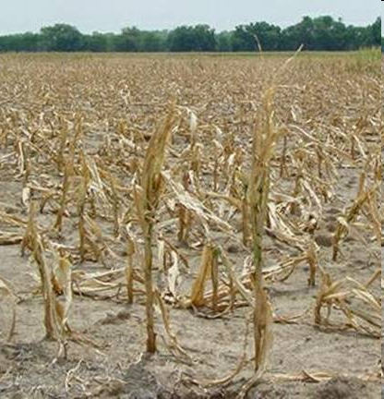
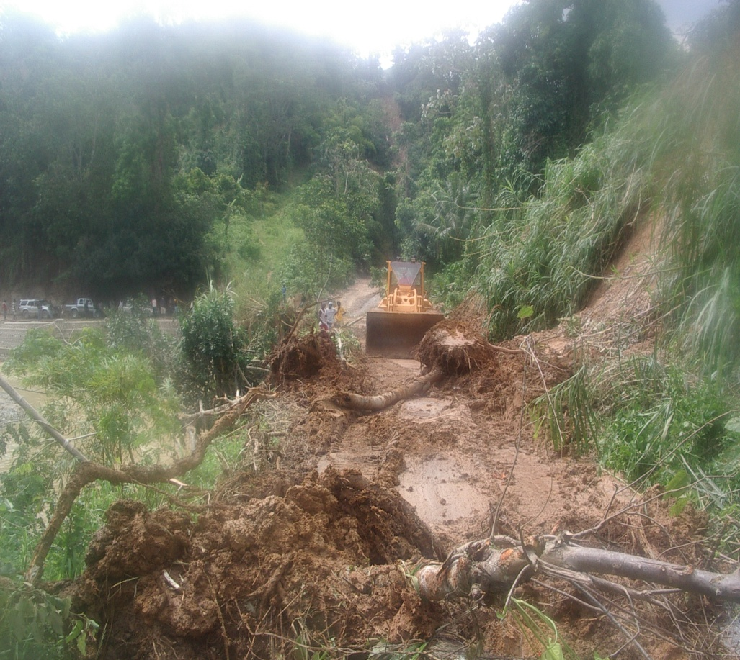
Implications for farmers
Low crop productivity
Land degradation, increase soil erosion/landslides

Slide 13
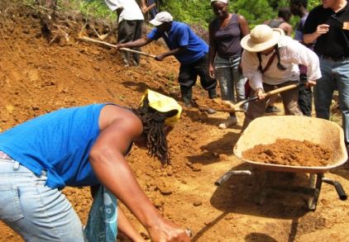
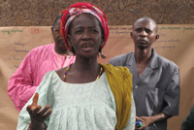
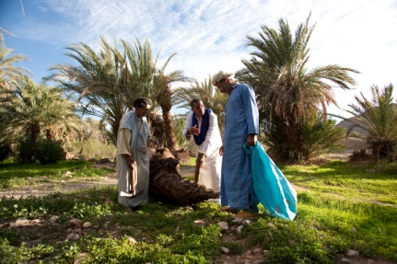
Community-Based Adaptation
UNDP’s Grassroots Response to Climate Change Adaptation
The United Nations Programme Development (UNDP) supports climate resilience and grassroots action through policy change. As climate change impacts are acutely felt by marginalized communities, especially the most poverty-stricken and vulnerable ones, UNDP’s CBA projects support local authorities and communities increase their capacity for adaption to and address long-term climate change.
UNDP’s CBA projects are designed to:
Strengthen the ability of communities to design and implement adaptive measures against climate change challenges.
Ensure that the communities’ voices are heard by governments and development agencies.
Support the diffusion of indigenous knowledge on managing climate-related risks.
Lessons and best practices learned from community-led initiatives inform the preparation of national policies.
Follows a community-driven approach wherein communities choose the projects and are provided with resources and financing to implement, thereby playing a catalytic and supportive role.
Bring UN agencies, governments, NGOs/CBOs, and other partners together to face climate change impacts.

Slide 14
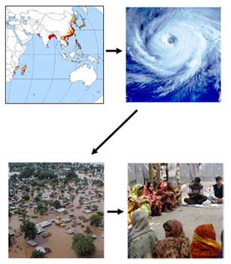
Community-based Adaptation – A Bottom-up Approach to Adaptation
Climate change is global, but impacts are regional and local
Impacts will affect different communities differently based on their specific circumstances
People in poor rural communities are the most severely affected by climate change impacts, but are often the least equipped to cope and adapt.
…so, solutions must be locally specific
CBA is community-driven
CBA is the grass-roots component of climate change adaptation
CBA will respond to locally specific needs, and develop lessons for global and national stakeholders to further adaptation practice

Slide 15
CBA Projects: What should they address?
CBA Projects are:
Community-driven …
Generate global environmental benefits
Address climate change risks
The CBA project will operate where all three of these priorities intersect
Community-Driven Priorities
CBA
Climate Change Adaptation Priorities
Global Environmental Benefits
15
Notes:
15

Slide 16
Formulating Adaptation Strategies out of “Barriers” determination (Understanding and Planning Phases)
UNDP Adaptation Policy Framework Step | VRA Indicator | VRA Question
 |  | In these examples, we consider the case of a community facing increasing drought risks
Assessing current vulnerability | 1. Vulnerability of livelihood/welfare to existing climate change and/or climate variability. | Example: What happens when there is drought? How does this affect you and your community?
Assessing future climate risks | 2. Vulnerability of livelihood/welfare to developing climate change risks. | Example: What would happen if drought was twice as frequent? How would this affect you and your community?
Formulating an adaptation strategy | 3. Magnitude of barriers (institutional, policy, technological, financial, etc) to adaptation. | Example: What stands in the way of adapting to increasing drought? What means do you or your community have to manage events occurring more frequently?
Continuing the adaptation process | 4. Ability and willingness of the community to sustain the project intervention | Example: Rate your confidence that the (project activity) will continue after the project period.

Slide 17
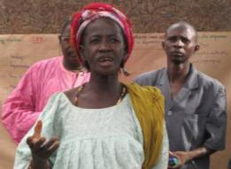
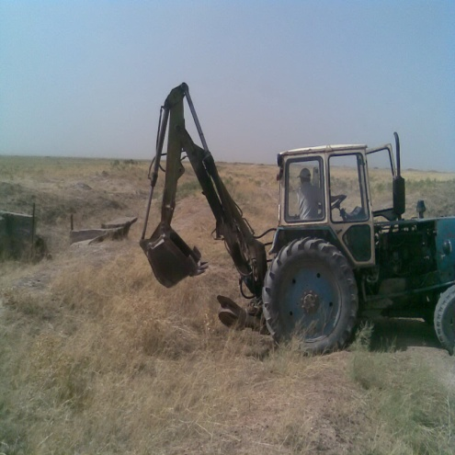
Phases of CBA Process
FOUR CRITICAL PHASES
Understanding Phase
Planning Phase
Managing & Implementation
Phase
Evaluating Effectiveness Phase

Slide 18
CBA Project Outcomes
Outcome 1: Local Level
Enhanced adaptive capacity allows communities to reduce their vulnerability to adverse impacts of future climate change driven risks
    Community-level capacity building and awareness-raising on climate change
    Portfolio of adaptation projects per country, in 42 countries
Outcome 2: National Level
National policies and programmes promote replication of best practices derived from CBA projects
    Dissemination/promotion of lessons learned at the national level
    Involvement of policymakers in CBA projects and processes
Outcome 3: Global Level
Cooperation among member countries promotes innovation in adaptation to climate change including variability
    Transboundary learning, based on best practices identified by communities
    Lessons learned on CBA transmitted to global stakeholders, including GEF-secretariat
Notes:
18

Slide 19
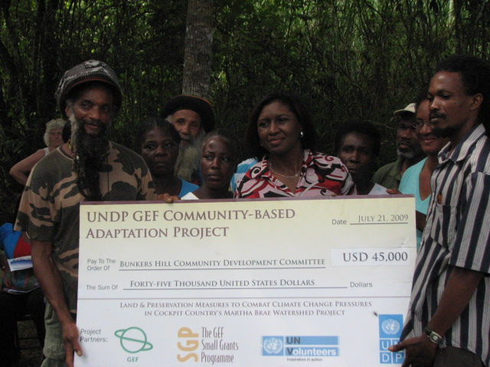
Community accepting funds disbursement for a CBA project

Slide 20
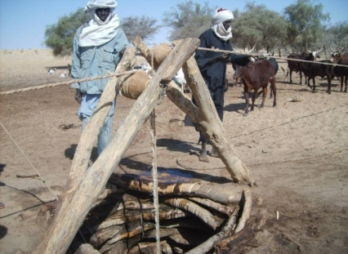
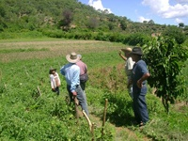
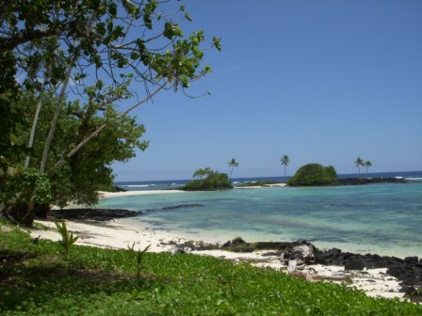
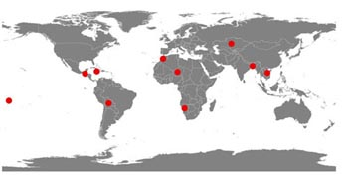
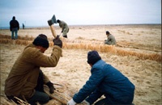





Community-Based Adaptation in Practice
Fast Facts on UNDP-CBA Programme
Implementation of over 200 projects in 42 countries to date
Grants provided up to $50K per project.
Leveraging existing delivery mechanisms at the local scale
Preparations underway to scale up support through Partnerships
Niger:
Protecting resources and optimizing resource cooperation in response to climate change
Bolivia:
Climate-resilient watershed management
Samoa:
Addressing climate-driven coastal hazards (erosion and stronger storms)
Kazakhstan: Piloting winter irrigation to replace declining snowfall
Notes:
20

Slide 21
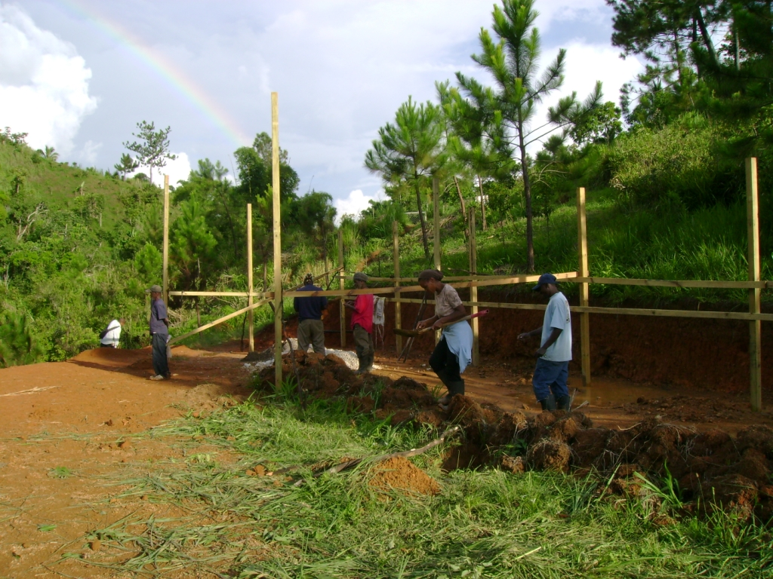
Community Members involved in construction of the green house

Slide 22
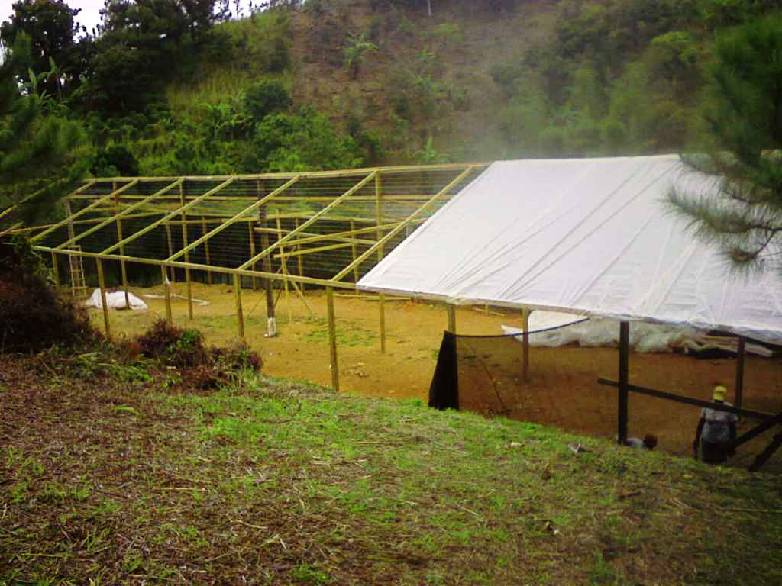
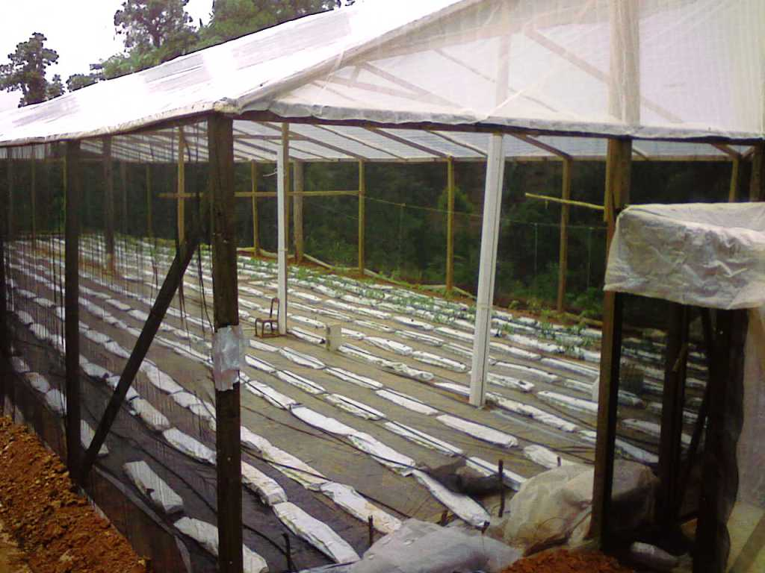
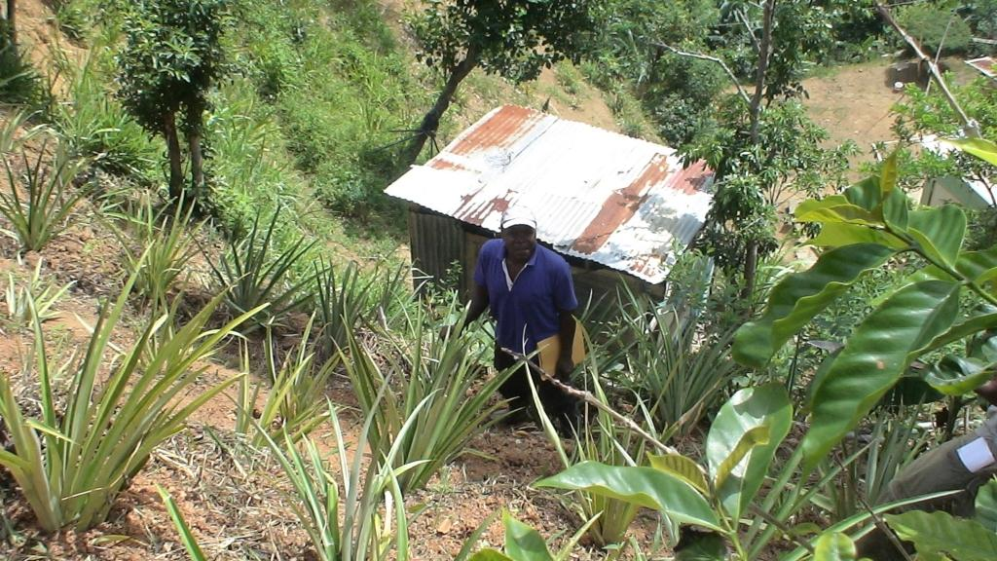
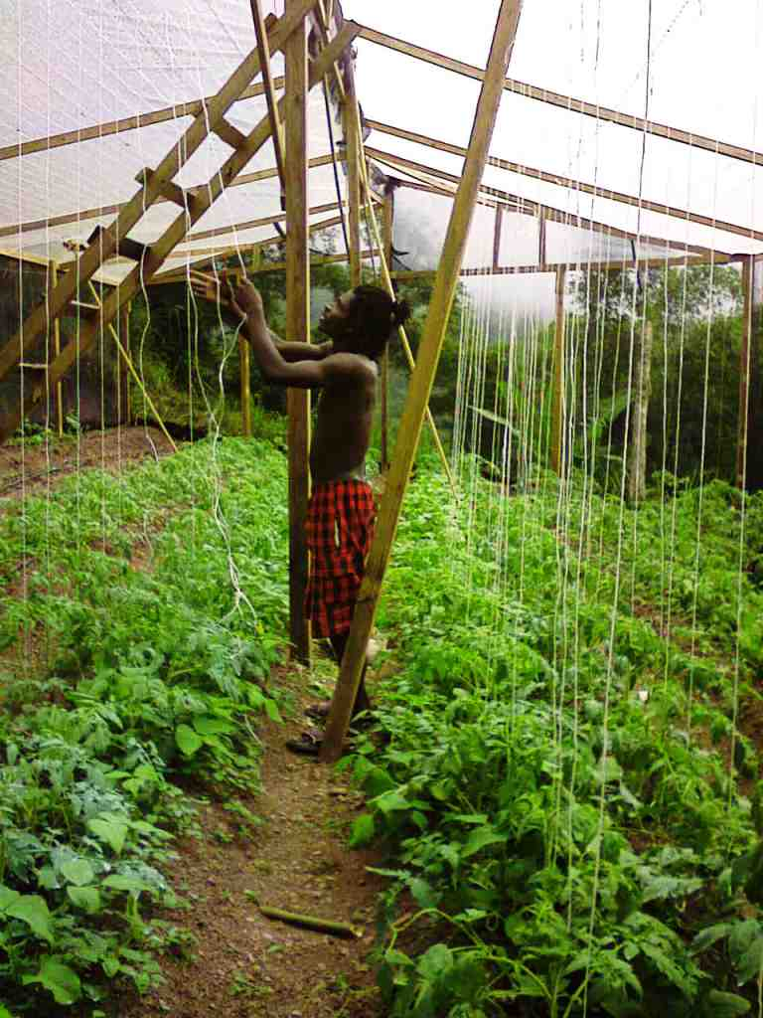
Activities under the project

Slide 23
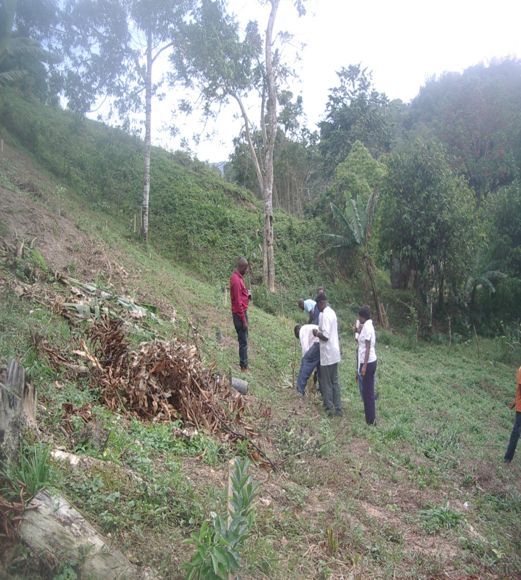
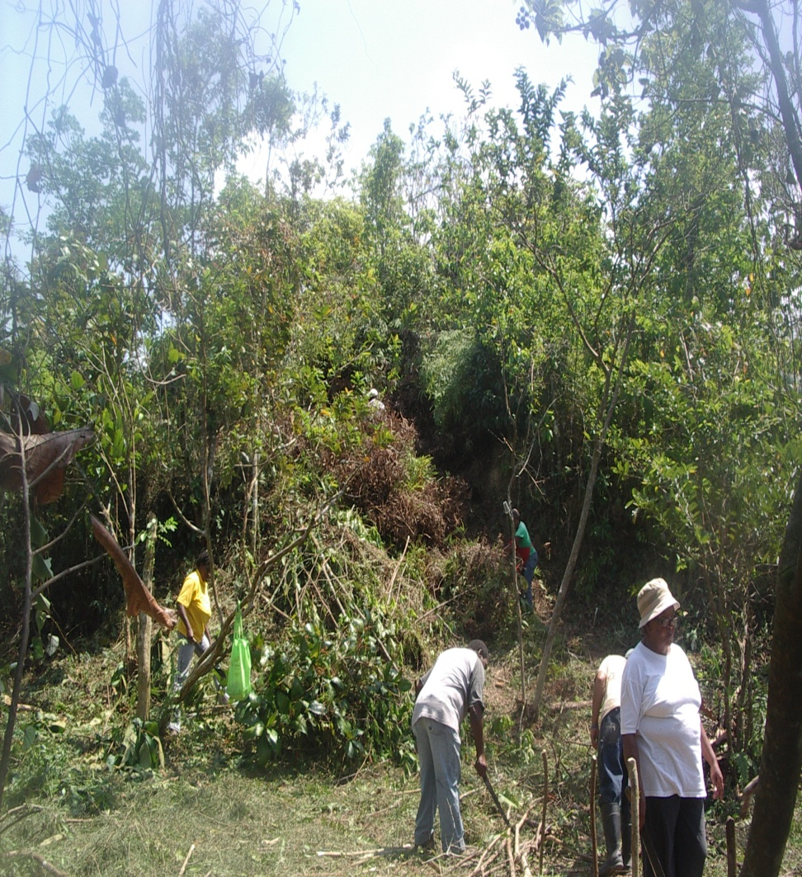
Community members working on farms

Slide 24
UNDP M&E Adaptation framework
ADAPTATION : What do we want to measure ?
We want to make sure our objectives are achieved : improving the adaptive capacity / reducing the vulnerability of the communities and the ecosystems on which they rely.
What can we measure ?
Coverage : extent to which the project reaches vulnerable stakeholders (individuals, households, businesses, government agencies, policymakers…)
Impact : extent to which the project reduces the vulnerability, through policymaking, capacity building…)
Sustainability : ability of stakeholders to continue the adaptation process beyond project lifetime
Replicability : extent to which projects generate and disseminate results and lessons of value for replication

Slide 25
UNDP M&E Adaptation Measurements at Project Level for all Thematic Areas
Coverage
i. Number of households, businesses engaged in vulnerability reduction or adaptive capacity development activities, as a proportion of households in the community or region targeted by the project.
ii. Number of policies introduced or adjusted to incorporate climate change risks.
iii. Number of investment decisions revised or made to incorporate climate change risks.
iv. Number of stakeholders (individuals, households, communities, etc.) served by new or expanded climate information management systems (e.g. early warning systems, forecasting, etc.).
Impact
i. Percent change in stakeholders’ behaviours utilizing adjusted practices or resources for managing climate change risks, assessed via QBS.
ii. Percent improvement in stakeholders’ capacities to manage climate change (e.g. communicate climate change risks, disseminate information, or make decisions based on high quality information), as relevant, assessed via QBS.
iii. Percent reduction in perceived vulnerability:
a. Percent improvement in stakeholder perceptions of vulnerability to a recurrence of primary climate change-related threat(s), assessed via QBS.

Slide 26
UNDP M+E Adaptation Measurements for all TA -ctd
Sustainability
i. Number of beneficiaries of project receiving training in implementation of specific adaptation measures or decision-support tools.
ii. Local (or spatially appropriate) availability of skills and resources necessary to continue adaptation after conclusion of project, assessed via QBS.
iii. Support for project activities among participating communities as assessed by QBS.
iv. Number of outside programmes, policies or projects incorporating project results into their processes.
Replicability
i. Number of “lessons learned” from the project

Slide 27
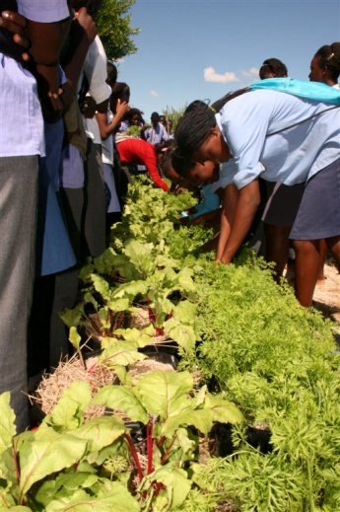
CBA in Namibian Schools
In Namibia a component of the CBA pilot programme is implemented by local NGO in collaboration with communities and schools. One combined primary and secondary school and one centre for orphans and vulnerable children in five northern regions battling with climate impacts illustrates the involvement of project in schools and in education sector.
Key Lessons and successes on Climate change adaptation and its replication in Namibian schools in the northern region.
The project worked with 87 pupils in grades 9 and 10 at the Onamulunga Combined School in northern Namibia.
The educational thrust included theoretical lessons and practical application of various technologies and practices
Various sites at the school were prepared for demonstrations on technologies and good practices
The pupils put the theory they learn in the classroom into practice in the field, growing maize, sunflowers, cow peas, spinach, carrots, onions and other vegetables.
The pupils were introduced to aquaculture in the school as part of co-curriculum.
The school became an adaptation learning centre for other schools in the region.
ALL These activities are linked to lifestyles and attitudinal changes within communities

Slide 28
Capacity Building Efforts on Communities
Capacity building of pupils, grantees and communities are the key entry points that the CBA project uses to facilitate and encouraged education on adaptation. These can be summarized as below:
Formal Education such as: Environmental education includes CCA in schools curricula, capacity building workshops, inter-country exchanges, competitions in schools, contributions to newsletters, flyer, books, and print media.
Informal Education through local institutions, observance of key international days, policy and capacity building processes. This includes: training (VRA, innovative technologies), WED, applied evidence based learning, demonstration projects, preparations to important earth summits/COP’s and etc.,
Strengthened education through Awareness both vertically and horizontally in community activities aimed at awareness such as “sand watch”, engaging with policy makers and parliamentarians, use of photo stories and videos for mass outreach, radio talks and TV shows, and other electronic media.
Key Areas of Education: Administration and finance management, community organization and mobilization, Gender equality, domestic violence, natural resource management; agroforestry; biodiversity; technology transfer, vulnerability, risks and threats (VRA) and income generation, access to health care and climate change adaptation.

Slide 30
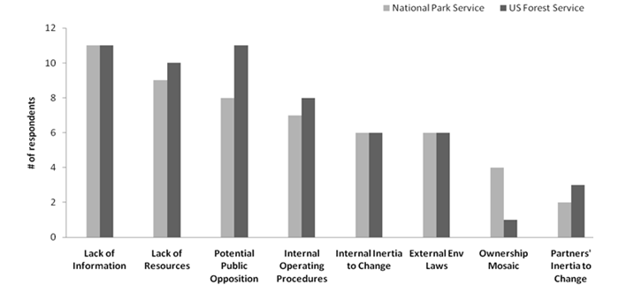
Sources of Challenges and Barriers for CBA Projects
Informational
Institutional
Socio-cultural
Technical/Communicative
External influence
Financial
Environmental
Laws

Slide 31
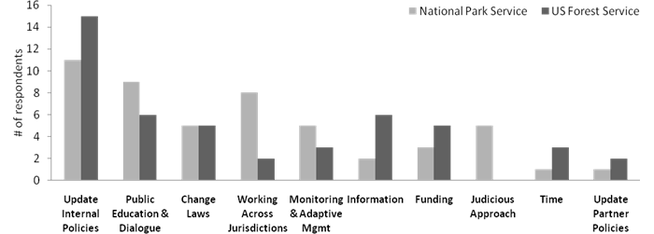
Implementation of Solutions to Common Barriers
Internal Policies indicates a perceived need for more internal societal guidance and cultural change
Education and Dialogue indicates a perceived need to engage the community and cultivate communal support for adaptation.
Change culture and bylaws indicates a perceived need for modification of existing local laws, or culture to provide societal direction for adaptation.
Working Across Jurisdictions/sectors indicates a perceived need to work with partner agencies across jurisdictions and manage at a broader spatial scale.
Monitoring and Adaptive Management indicates a perceived need to understand how natural resources are changing in relation to climate change in locality.
Information (e.g., predictive models), Funding and Time indicate a perceived need for these types of resources in order to implement more climate change adaptation projects in the future.
Judicious Approach indicates a perceived need for cultural and policy changes to be based on sound local science.
Update Partner Polices indicates a perceived need to change partners' traditional approaches and policies to be more supportive of adaptation.

Slide 32
Video Links of the Kinds of Projects Support by SGP in Communities
http://insightshare.org/watch/video/samoa
http://www.undp-alm.org/resources/videos/community-based-adaptation-informational-video-2010
http://www.undp-alm.org/resources/videos/cba-bolivia-semillas-del-futuro-vol1
http://www.undp-alm.org/resources/videos/cba-jamaica-un-volunteers-climate-change-issues-glengoffe
http://www.undp-alm.org/resources/videos/cba-morocco-sees-mix-community-volunteers-and-unv-volunteers
http://www.undp-alm.org/resources/videos/self-service-cba-namibia-un-volunteers-video
http://www.undp-alm.org/resources/videos/undp-niger-ranet-0
http://www.undp-alm.org/resources/videos/cba-reducing-risks-samoa-unv-video

